Slide 1

HP Inc. — Investor Overview
A deep-dive into one of the world's most recognized technology companies: its business architecture, revenue model, competitive positioning, and strategic trajectory for sophisticated institutional investors and venture capital analysts.
INVESTOR BRIEFING
FY 2024

Slide 2
Company Background & History
HP Inc. is a Fortune 500 technology company headquartered in Palo Alto, California — the very birthplace of Silicon Valley. Founded in 1939 by Bill Hewlett and Dave Packard in a now-legendary one-car garage, HP grew from an audio oscillator manufacturer into one of the most globally diversified technology conglomerates in history. The company's founding ethos — engineering excellence, employee respect, and long-term thinking — became the template for modern Silicon Valley culture.
In November 2015, Hewlett-Packard Company executed one of the largest corporate splits in technology history, separating into two independent, publicly traded entities: HP Inc. (NYSE: HPQ), retaining the Printing and Personal Systems businesses, and Hewlett Packard Enterprise (HPE), housing the enterprise technology infrastructure divisions. This strategic separation was designed to give each entity the agility to compete and invest in its respective market without the friction of operating across radically different customer segments.
1939
Founded by Hewlett & Packard in Palo Alto garage
1957
HP goes public on NYSE
1984
LaserJet printer launched — revolutionizes office printing
2015
Corporate split into HP Inc. and HPE
2024
$53B+ revenue, 58,000+ employees worldwide
Today, HP Inc. operates across 170+ countries, serves hundreds of millions of customers, and continues to invest heavily in next-generation computing, sustainable print technology, and hybrid work solutions. Its deep brand equity and entrenched channel relationships represent formidable competitive moats that few technology peers can replicate.

Slide 3
Mission, Vision & Strategic Philosophy
Mission Statement
Strategic Philosophy for Investors
To create technology that makes life better for everyone, everywhere — every person, every organization, and every community around the globe.
HP Inc.'s strategic framework rests on three foundational pillars that anchor its long-term value creation thesis:
1
Reinvent the Core
Vision Statement
Continuously evolve the printing and personal systems businesses through AI integration, subscription-based recurring revenue, and premium product tiering to defend margins and expand wallet share.
To be the most innovative, trusted, and sustainable technology company delivering exceptional experiences to our customers, partners, and the world at large.
Core Values
2
Scale Future Bets
Partner first — ecosystem-driven growth
Accelerate — urgency and innovation velocity
Act with integrity in every market
Drive sustainability as a business imperative
Invest aggressively in adjacencies — industrial 3D printing, hybrid workforce solutions, workforce experience platforms, and security-embedded hardware — to unlock new total addressable markets.
3
Lead with Sustainability
Position HP's environmental leadership — circular economy commitments, carbon neutrality goals, and responsible supply chains — as a differentiated enterprise selling point and ESG investment thesis.

Slide 4
Core Business Segments
HP Inc. operates through three clearly defined, financially reportable business segments. Together they form a balanced, diversified portfolio where hardware drives volume, services drive recurring revenue, and innovation drives long-term differentiation.
🖨️ Printing
💻 Personal Systems
⚙️ Services & Solutions
~35% of Total Revenue
~65% of Total Revenue
High-Margin Growth Engine
HP's printing segment encompasses consumer inkjet printers, enterprise laser printers, managed print services (MPS), and industrial print solutions. The segment's profitability engine is its razor-and-blades model — hardware is sold at modest margins while ink and toner cartridges, supplies, and service contracts generate high-margin recurring cash flows. HP Instant Ink, its subscription-based ink delivery service, now counts millions of enrolled subscribers globally, representing a structural shift toward predictable revenue.
The largest segment by revenue, Personal Systems covers consumer and commercial laptops, desktops, workstations, thin clients, and accessories. HP holds the #1 or #2 global PC market share position (competing directly with Lenovo) across most quarters. The commercial segment — targeting enterprise and SMB customers — commands significantly higher average selling prices and gross margins than consumer PCs. The hybrid work secular tailwind continues to support premium device refresh cycles.
HP's services portfolio includes Device-as-a-Service (DaaS), managed print services, IT lifecycle services, workforce experience platforms, and HP Wolf Security — an embedded, silicon-to-cloud cybersecurity architecture built natively into HP hardware. Services represent HP's most strategically important growth vector as they deliver sticky, recurring, high-NPS revenue streams that transform HP from a transaction vendor into a long-term strategic partner.

Slide 5


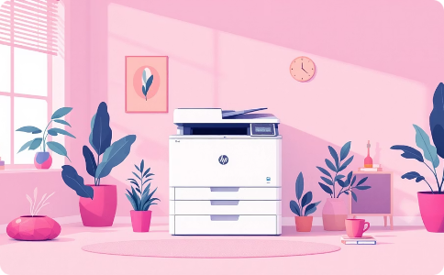
Key Products & Solutions Portfolio
HP Inc. maintains one of the broadest and most recognized product portfolios in the technology industry, spanning prosumer, commercial, and industrial use cases. Its portfolio strategy emphasizes premium positioning, security integration, and ecosystem lock-in across hardware, software, and services.
Commercial PCs — EliteBook & ZBook Series
Consumer Premium — Spectre & Envy Series
Enterprise Printing & Managed Print Services
HP's flagship business laptop lines target enterprise and SMB customers with built-in HP Wolf Security, Intel vPro or AMD Pro processors, and premium build quality. The EliteBook Dragonfly commands ASPs well above commodity laptop ranges, supporting healthy segment gross margins. ZBook workstations serve creative professionals and engineering teams with certified ISV compatibility for CAD and 3D workloads.
HP's consumer premium lineup competes directly with Apple MacBook and Dell XPS. The Spectre x360 convertible consistently earns top-tier reviews and commands premium pricing, building aspirational brand equity that lifts the broader HP consumer portfolio. The Envy series targets the value-premium segment, bridging the gap between mass-market and high-end buyers.
HP's LaserJet and PageWide enterprise printers are deeply entrenched in corporate and government print infrastructure globally. HP Managed Print Services (MPS) overlays software, analytics, and service contracts onto hardware deployments, dramatically improving revenue predictability and customer switching costs. HP's Instant Ink subscription model extends similar recurring dynamics into the consumer and SMB segments.
🏭 Industrial 3D Printing — HP Multi Jet Fusion
🔐 HP Wolf Security — Embedded Cybersecurity
HP's industrial 3D printing platform is a strategic bet on the future of additive manufacturing. Multi Jet Fusion technology enables production-grade plastic and metal part manufacturing at speeds 10x faster than competing processes. HP serves aerospace, automotive, healthcare, and consumer goods customers, with the platform generating both hardware and high-margin materials revenue. This segment represents a long-duration growth option embedded in HP's current valuation.
HP Wolf Security is a silicon-to-cloud endpoint security architecture that is natively embedded in HP commercial hardware. As enterprise customers increasingly require security-by-design rather than security-as-afterthought, Wolf Security has become a meaningful commercial differentiator and deal-closer in competitive enterprise PC bids. HP Wolf Security also extends into software services, enabling incremental recurring revenue on top of hardware transactions.

Slide 6

Revenue Streams & Monetization Model
HP Inc.'s monetization architecture is sophisticated and multi-layered — evolving deliberately from a pure transactional hardware model toward a hybrid model that increasingly captures recurring, high-margin service and subscription revenues. This structural shift is the single most important investment thesis driver for HP's long-term multiple expansion.
Revenue Architecture Overview
Hardware Transactions
Supplies & Consumables (Annuity)
PCs, printers, workstations, and accessories sold through direct, channel, and e-commerce routes. Volume-driven, moderate margins. Growth tied to PC refresh cycles and commercial fleet expansion.
Ink cartridges, toner, and paper represent HP's highest-margin revenue stream. Installed base of hundreds of millions of printers creates a durable, recurring consumables revenue annuity that generates strong free cash flow independent of new hardware sales cycles.
Personal Systems Hardware·55%
·55%
Print Supplies & Ink·20%
·
·20%
·
Print Hardware·10%
·10%
·
Services & Subscriptions·10%
·10%
Industrial & Other·5%
·
·5%
·
Subscription & As-a-Service
Software & Security Services
HP Instant Ink (ink subscription), Device-as-a-Service (DaaS for commercial PC fleets), and Managed Print Services convert one-time hardware transactions into multi-year contractual revenue relationships. Subscription ARR is growing double-digits YoY and represents the most valuable component of HP's future revenue mix.
HP Wolf Security software licensing, print fleet analytics (HP Workpath), and workforce experience platform fees add a pure-software revenue layer atop HP's hardware installed base — carrying gross margins of 70%+ and meaningfully accretive to blended company margins.

Slide 7

Target Customer Segments & Global Footprint
HP Inc. serves one of the broadest and most diverse customer bases in the technology industry — spanning individual consumers to the world's largest multinational enterprises. This breadth creates natural demand diversification, reducing cyclicality risk while providing HP with unmatched distribution leverage across global markets.
Enterprise & Large Corporations
Small & Medium Businesses (SMB)
Consumer & Prosumer
Fortune 500 companies, government agencies, and large public sector organizations represent HP's highest-value customer tier. Enterprise accounts purchase commercial PC fleets (thousands of units per refresh cycle), enterprise-grade printing infrastructure, managed print service contracts, DaaS agreements, and HP Wolf Security deployments. HP's global enterprise sales force, partner ecosystem (including major system integrators like Accenture, DXC, and CDW), and deep procurement relationships provide formidable barriers to competitive displacement. Average contract values range from $500K to multi-million-dollar multi-year managed service agreements.
SMB customers — businesses with 10 to 500 employees — represent HP's largest customer count segment and a critical growth opportunity. SMBs increasingly need enterprise-grade security, manageability, and reliability in their IT infrastructure but lack dedicated IT departments to manage complexity. HP's SMB-focused offerings (HP Business PCs, HP LaserJet Pro series, HP Instant Ink for Business, and simplified DaaS packages) are specifically engineered to deliver enterprise capability at SMB-appropriate price points and management simplicity. HP's extensive channel partner network of VARs and IT resellers is the primary go-to-market engine for the SMB segment.
Hundreds of millions of individual consumers globally use HP laptops, desktop PCs, and home printers. The consumer segment, while lower in ASP and margin relative to commercial, provides enormous volume scale, brand reinforcement, and a feeder pipeline for commercial purchases as consumers bring HP device preferences into workplace procurement decisions. HP Instant Ink's consumer subscription model is converting this massive installed base into recurring revenue contributors. The prosumer segment — photographers, video creators, designers — is served by the HP Envy, Spectre, and DesignJet product lines at premium price points.
Global Footprint at a Glance
170+
58K+
$53B+
#1–2
Countries of Operation
Global Employees
Annual Revenue
Global PC Market Share
HP sells products and services across more than 170 countries through direct sales, online channels, and an extensive global partner network.
HP's global workforce spans R&D, manufacturing, sales, and support functions across every major geography.
HP's annual revenue run rate places it firmly in the global top-tier technology company rankings by scale.
HP consistently holds the #1 or #2 position in global PC market share, competing neck-and-neck with Lenovo across most quarters and geographies.

Slide 8
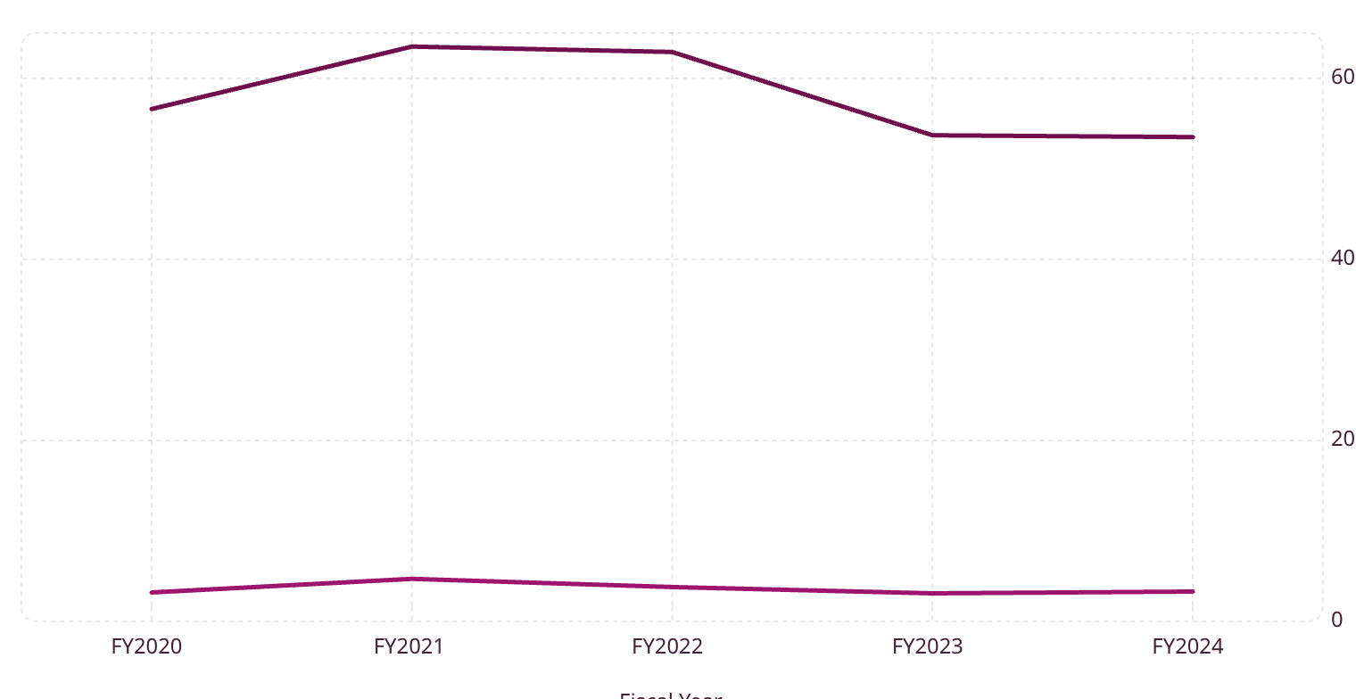
Recent Financial & Strategic Highlights
Free Cash Flow ($B)
Revenue ($B)
Key Strategic Highlights — FY2023–2024
AI PC Portfolio Launch
HP launched its comprehensive AI PC lineup featuring Microsoft Copilot+ integration and on-device NPU (Neural Processing Unit) chips from Intel and Qualcomm Snapdragon X Elite. AI PCs represent the catalyst for the next major commercial PC refresh cycle — enterprises refreshing 3–5-year-old fleets without AI capability — and HP is exceptionally well-positioned to capture this upgrade wave.
Aggressive Share Buyback Program
HP has returned billions of dollars to shareholders through consistent share repurchases, reducing diluted share count materially and delivering meaningful EPS accretion. HP's capital return philosophy prioritizes shareholder value while maintaining investment capacity for organic and inorganic growth initiatives.
HP's revenue reflects the post-COVID PC demand normalization cycle. Free cash flow generation has remained resilient, underscoring operational discipline and the structural strength of HP's print supplies annuity business.
Future Ready Transformation Plan
HP's multi-year cost restructuring program targets $1.4B in annualized structural cost savings through workforce optimization, supply chain rationalization, and go-to-market simplification. This program directly expands operating margins and funds reinvestment into high-growth segments like AI PCs, 3D printing, and DaaS services.
Sustainability Commitments Advancing
HP achieved carbon neutrality in its own operations and has committed to net-zero value chain emissions by 2040. Over 80% of HP product packaging is made from sustainably sourced or recycled materials. These credentials are increasingly important in enterprise procurement criteria and ESG-focused institutional investment mandates.

Slide 9
Competitive Positioning & Strategic Focus Areas
HP Inc. operates in intensely competitive markets but benefits from durable moats — brand equity, channel depth, installed base scale, and embedded security architecture — that are exceptionally difficult for challengers to replicate at equivalent cost or speed.
Competitive Landscape
Strategic Focus Areas — The Forward Investment Thesis
Competitor
Primary Overlap
HP Advantage
01
Lenovo
Commercial & Consumer PCs
Brand premium, Wolf Security, DaaS ecosystem
AI PC Refresh Supercycle
Capitalize on the largest commercial PC refresh opportunity in a decade, driven by AI capability requirements, Windows 11 migration, and hybrid work infrastructure modernization.
Dell Technologies
Commercial PCs, Workstations
Print synergies, broader SMB channel coverage
Apple
Consumer Premium Laptops
Windows ecosystem, enterprise manageability, price accessibility
02
As-a-Service Recurring Revenue Expansion
Accelerate DaaS and HP Instant Ink subscriber growth to shift revenue mix toward predictable, high-NPS subscription and service revenue — directly supporting multiple expansion.
Canon / Epson
Consumer & SMB Printing
Managed Print Services depth, enterprise installed base
Xerox
Enterprise MPS
Hardware + services integration, global scale
03
Industrial 3D Printing Commercialization
Scale the Multi Jet Fusion platform into production manufacturing adjacencies, unlocking a $50B+ total addressable market over the next decade with differentiated materials science IP.
04
Embedded Security as a Moat
Extend HP Wolf Security into a standalone enterprise security services revenue line, converting a hardware differentiator into a recurring software and services revenue stream with 70%+ gross margins.
Investment Summary: HP Inc. represents a disciplined, cash-generative technology franchise with durable competitive moats, a credible AI PC refresh catalyst, and a deliberate structural shift toward recurring revenue that should support long-term earnings per share growth and capital return to shareholders. The combination of a deeply entrenched print supplies annuity, growing DaaS/subscription revenue, and an AI PC portfolio positioned for the next enterprise refresh cycle creates a compelling risk-adjusted investment case for patient, value-oriented institutional capital.

